Slide 1
Electric Fields due to Point Charges

Slide 2

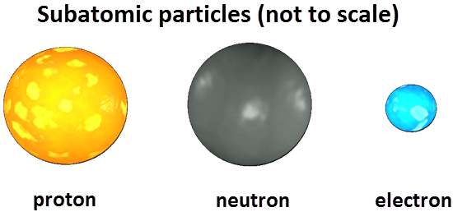
Matter is made up of atoms, which were once thought to be indivisible. They were considered the smallest possible objects in the universe.
Now we know that atoms are made up of still smaller particles - protons, electrons and neutrons. The major difference between these three particles is that they all have a different charge. Protons have a positive charge, electrons have an equal but opposite negative charge, while neutrons have no charge at all and are neutral.

Slide 3
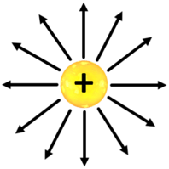
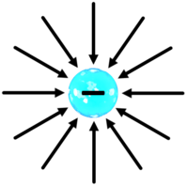
The space around a charged particle contains something called an electric field. We can't see this field or measure it directly. However, we can work out its properties by looking at how it affects other charged particles. Traditionally we draw it as a series of arrows (vectors), which point from areas of positive charge to areas of negative charge.
This is how we draw the electric field around a proton. It looks like a series of vectors arranged like the spokes of a wheel, with the proton at the centre. All the vectors point away from the proton - this is how we know it's positively charged.
For an electron, the field vectors point the other way, toward the particle. This is because it has a negative charge, opposite to that of the proton.

Slide 4
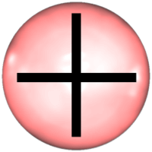
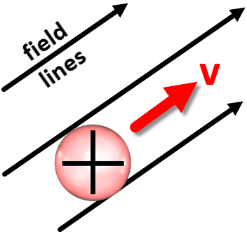
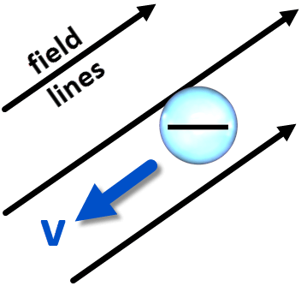
Let's see what happens when we throw a test charge into an electric field. A test charge is a charged particle that is so small it doesn't change the shape of the field. We will use a tiny positive charge, a fraction of the size of a proton.
When this test charge is exposed to an electrostatic (non-moving) field, it experiences a force. The force causes it to accelerate along the lines of the field like this:
However, if we replace the positive test charge with a negative one, we see the opposite. It accelerates in the opposite direction to the electric field lines! As we will see later, this is the same motion electrons show in circuits.

Slide 5
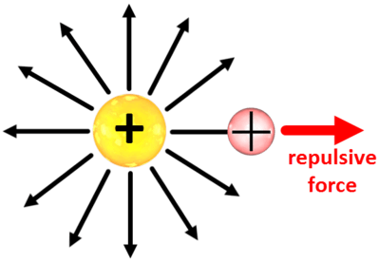
What does a positive test charge do when you place it next to a proton? According to our observations, it will move along the electric field lines that go out from the proton.
In other words, the test charge moves away from the proton. This is called repulsion.
Any positive charge applies a repulsive force to any other positive charge. You may have heard the word 'repulsive' used to mean 'ugly', but in Physics it's really a beautiful idea.

Slide 6
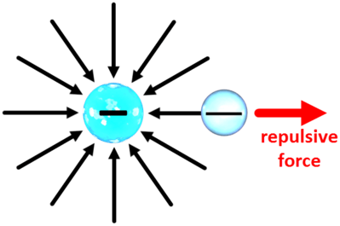
This also happens with negative charges. If you place a negative test charge in the electric field created by an electron, it moves opposite to the field lines, which go into the electron. This means the test charge is repelled by the electron.
In summary, we can say that like charges always repel each other. This is one of the most fundamental ideas in the study of electrical physics!

Slide 7
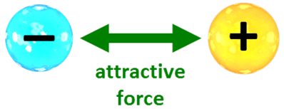
What happens when you place a negatively charged particle, like an electron, in the electric field of a positively charged particle, like a proton?
In this case, we do not see repulsion! The negative charge will move opposite to the field lines coming out of the positive charge. At the same time, the positive charge accelerates along the field lines that go into the negative charge.
The net result is that both particles feel a mutual attractive force and they move toward each other. This is where the phrase "opposites attract" comes from - opposing charges always attract each other.

